Slide 1
frenZone
Introduction
‘Frenzone’ is a social networking site developed with a view to provide the user with the communication facility .The main objective of ‘frenzone’ is to provide facility of communicating ,sharing ideas & thoughts .Moreover it also facilitaes user with unique photo identity so that he/she can be easily recognised by others.

Slide 2
frenZone
Requirements
Operating system:Windows 2000 or above
Disk space: 1 gb or more
Ram :1 gb
Graphics:512 mb

Slide 3
frenZone
Objective
Though ‘frenzone’ is developed with multiple objective, the notable objectives of ‘frenzone’ are listed below:
1.Providing easy and cheaper connectivity to the user.
2.Providing easy method to create user account with out any complications .
3.Providing facility for user to share views , information and photos
4.Easy database support to store the information of user and retrive it later when needed.

Slide 4
frenZone
Key Features:
1.Creating Unique password protected user account with photo identity.
2.Sharing ideas,views and photos .
3.Comments and likes in the photo.
4.Downloading images for future use.

Slide 5
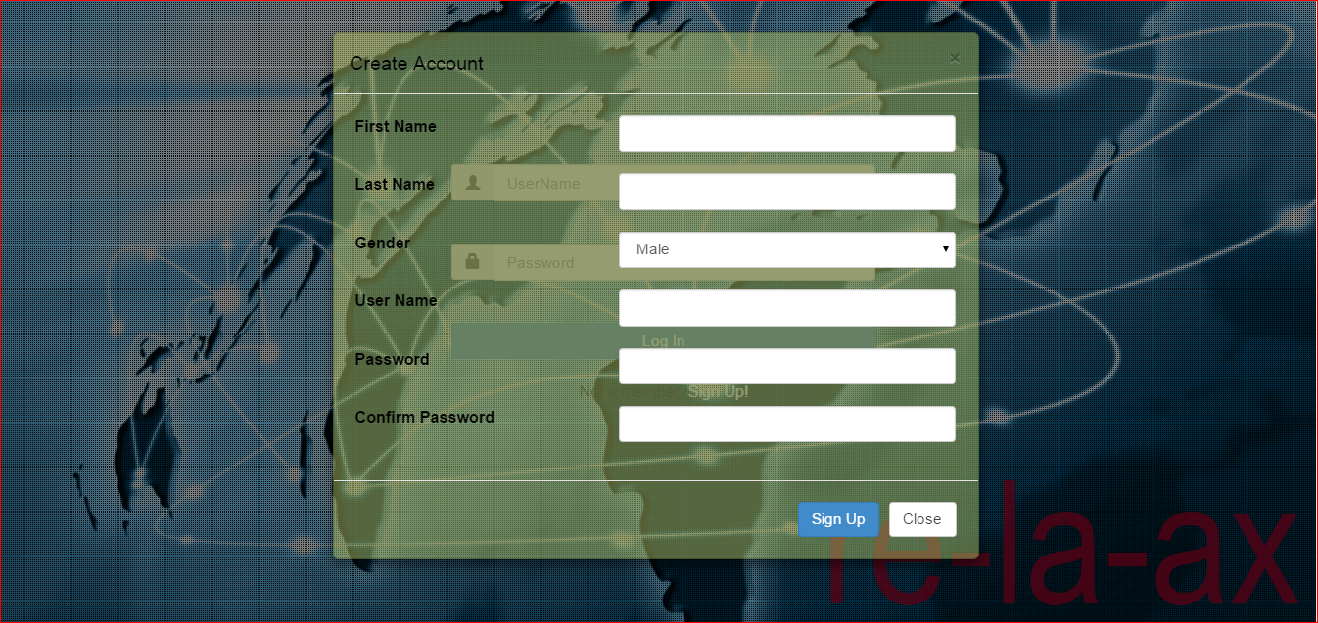
Sign up page from where we can create new account

Slide 6
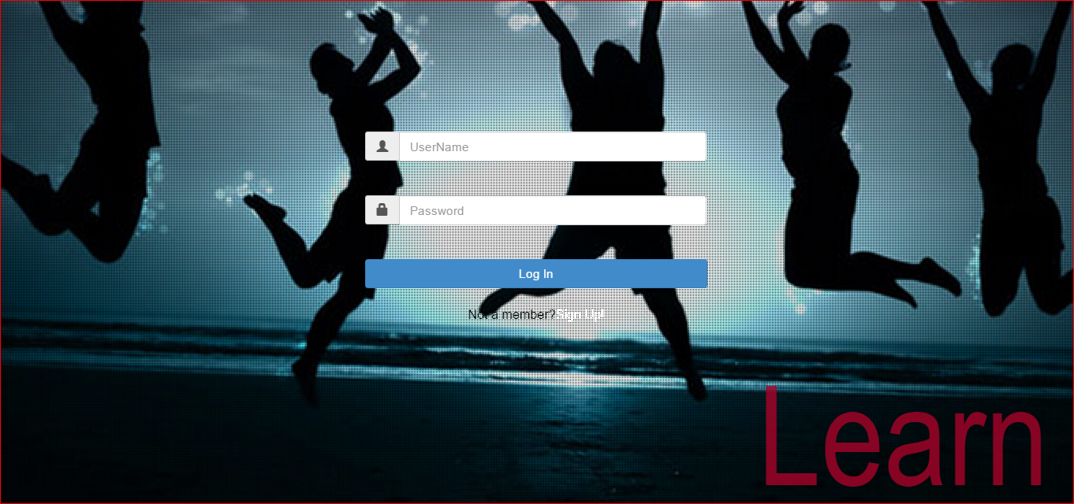
Login page where user can enter the unique user id and password to get access

Slide 7
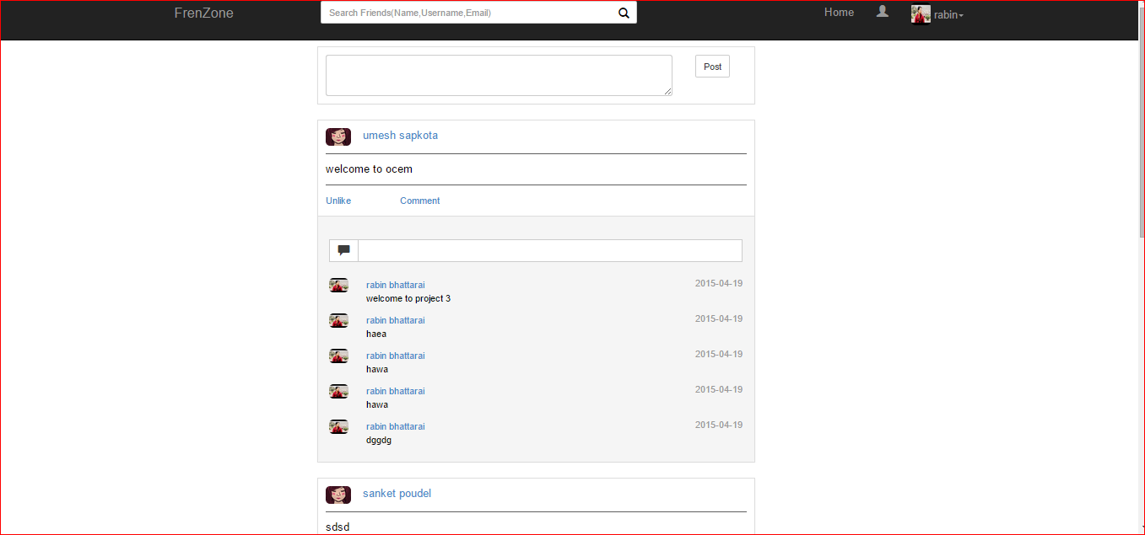
Home page after login

Slide 8
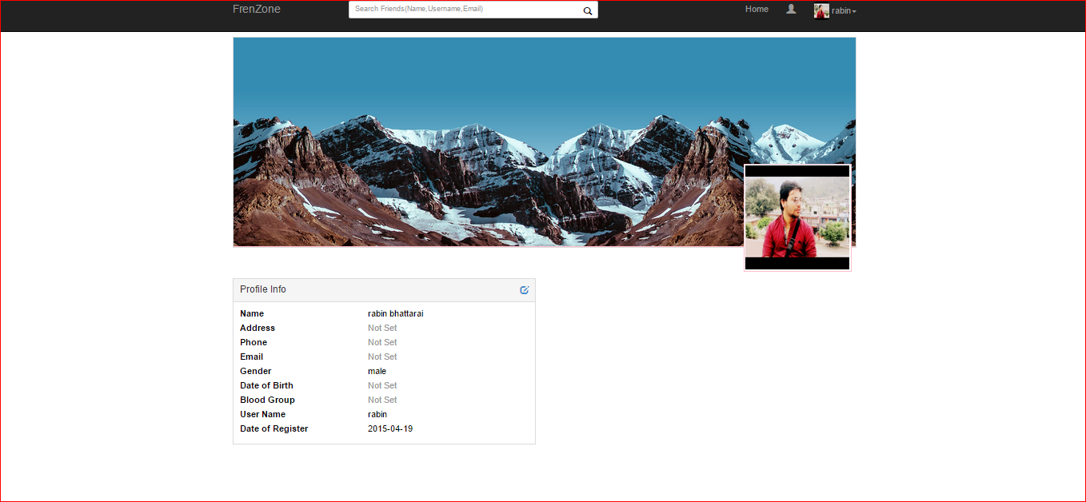
User personal profile page

Slide 9
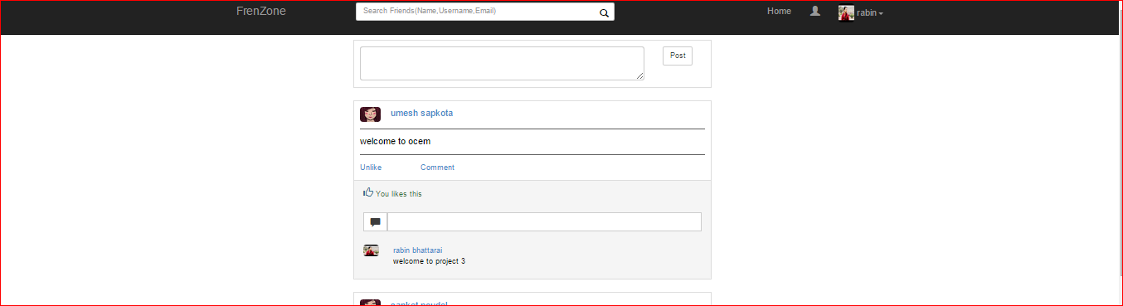
Updating status

Slide 10
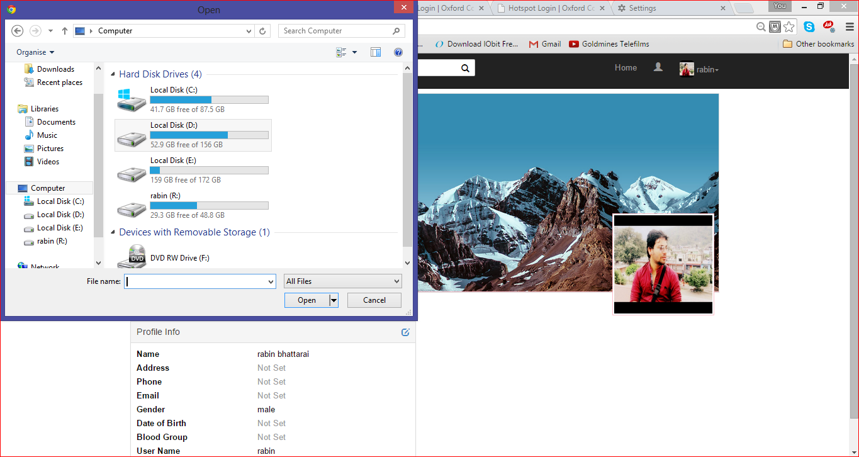
Uploading a photo

Slide 11
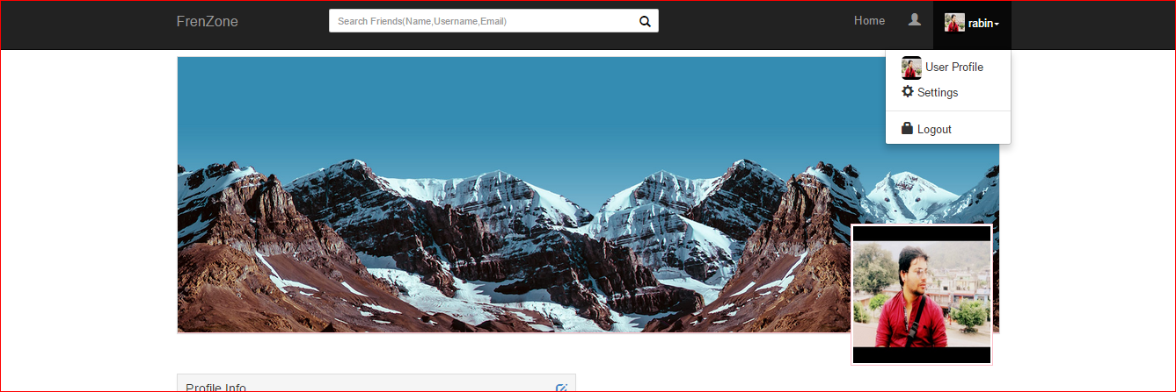
Setting for the user

Slide 12
Thank you

